Slide 1
Port Rocket Chip on zcu102
First step needed by UINTR in RISC-V
—— 计93 田凯夫 2019011264

Slide 2
Overview
A clear vivado project managed by digilent scripts
A lighter block design compared with Labeled-RISC-V
A custom Rocket Chip built from scratch

Slide 3
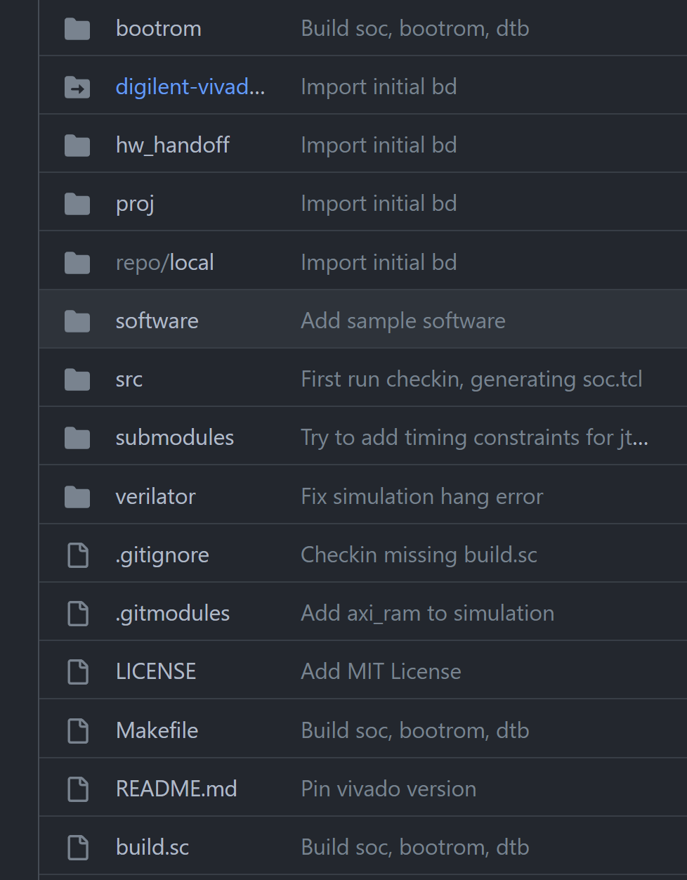
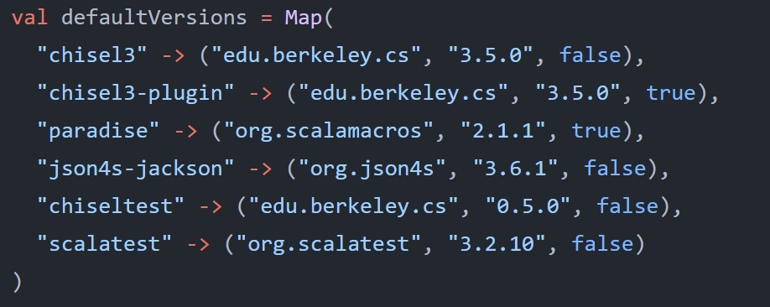
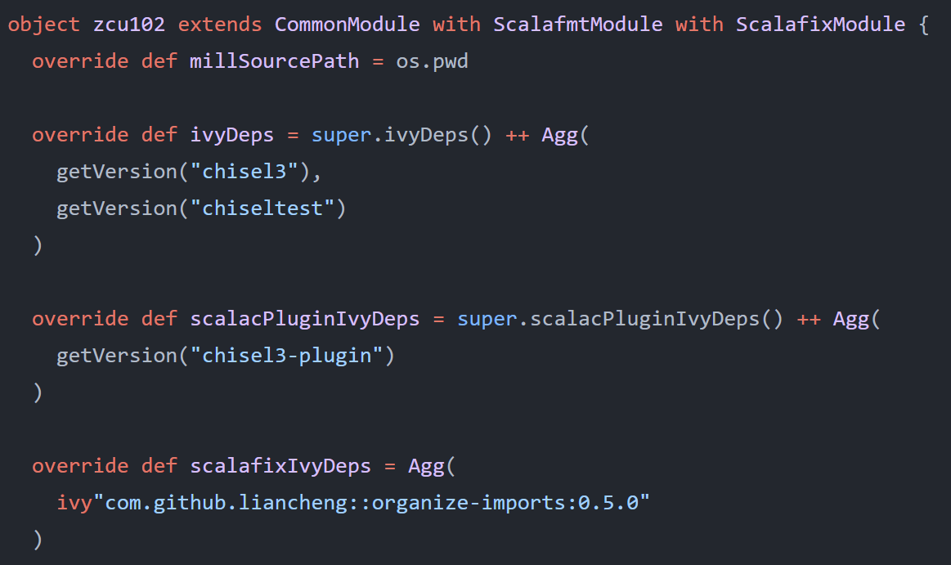
Vivado project
Simple command: checkin and checkout to manage vivado version migration
Mill: build chisel project, version control
Edit the chisel3 project IntelliJ IDEA via mill mill.scalalib.GenIdea/idea

Slide 4
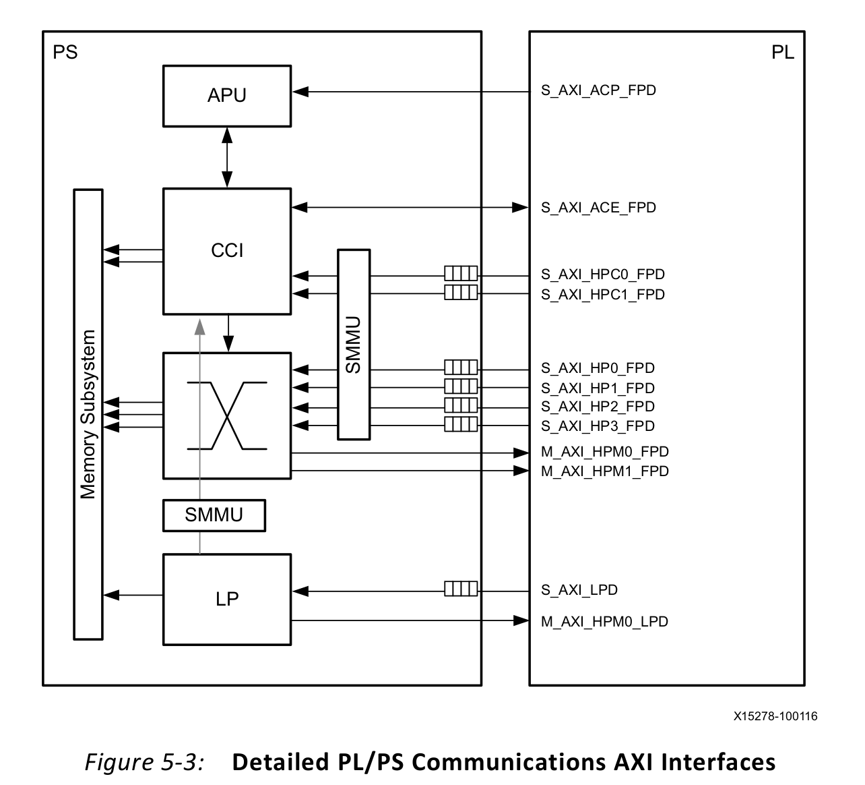
Block Design: Zynq UltraScale+MPSoC
Communication between PS and PL: AXI Interfaces, interrupts
4 UART 16550 controllers
AXI GPIO controller for PL reset
AXI GPIO controller for interrupt from PS to PL
AXI Jtag

Slide 5
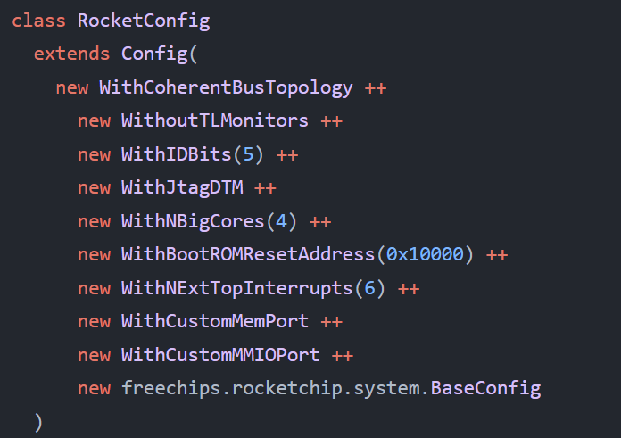
Rocket Chip
Custom MMIO Port
Custom MEM Port
BootROM Configs
Jtag Configs

Slide 6
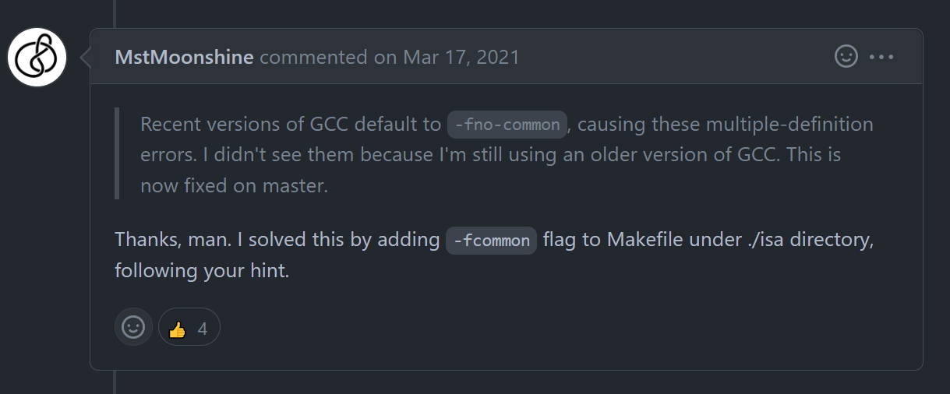
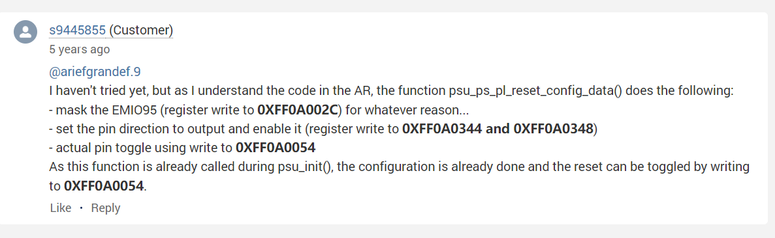
Problems
Few projects with old version of Vivado and Rocket: Hard to copy and reimplement.
Few documents for Rocket Chip
Scattered discussions about zcu102
Many efforts on …

Slide 7
Plans
Boot linux on Rocket (Not Yet)
Implement user interrupt controller

Slide 8
Thanks

